Slide 1

Renewable Resources and Clean Energy
Their role in South Carolina’s Electric Generation Portfolio

Slide 2

What is a renewable resource?
An energy resource that is naturally replenished in a relatively short period of time.
These include:
Solar Energy
Wind Energy
Biomass
Geothermal Energy
Hydropower

Slide 3
Why Renewable Resources?
Demand for electricity continues to increase
Fossil fuel-fired plants are responsible for: ⁺
  67% of nation’s sulfur dioxide emissions
  23% of nitrogen oxide emissions
  40% of man-made carbon dioxide emissions
Technology is making fossil fuels cleaner but there is demand for lower emissions
Fossil fuel supplies are depleted faster than they can be generated
⁺Source: U.S. Environmental Protection Agency (2007) http://www.epa.gov/cleanenergy/energy-and-you/affect/air-emissions.html

Slide 4
4
*Source: Energy Information Administration (2007 data) http://www.eia.doe.gov/emeu/aer/txt/ptb0802b.html
⁺Source: ORS Energy Policy Report (2007 data) http://www.regulatorystaff.sc.gov/Energy%20Policy%20Report%20website.pdf

Slide 5
Capacity Factor
A way to measure the productivity of power plants
Actual Power Produced
Power that would have been produced if
plant operated at 100% all the time
Capacity Factor =

Slide 6
Capacity Factor
+Source: Energy Information Administration (2007 data) http://www.eia.doe.gov/cneaf/electricity/epa/epata6.html
* Source: La Capra study (2007 data) http://www.energy.sc.gov/publications/Renewables%20Potential%20Final%20Report%20-09-12-2007-B.ppt

Slide 7
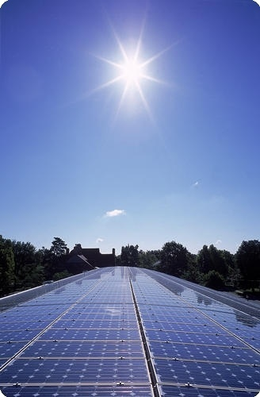
Solar Energy
Converting the Sun’s energy into electricity
7

Slide 8
Advantages of Solar Energy⁺
Air emissions are insignificant because no fuels are combusted
  No sulfur dioxide emissions
  No nitrogen oxide emissions
  No carbon dioxide emissions
Photovoltaic (PV) systems do not require the use of water to generate electricity
  Not affected by drought or limited water resources
  No concern of environmental impact on rivers and lakes
⁺ Source: U.S. Environmental Protection Agency (2007) http://www.epa.gov/solar/energy-and-you/index.html

Slide 9
Advantages of Solar Energy ⁺
PV systems can be placed on existing structures, requiring no new land
  Schools, office buildings, etc. can be utilized
The Sun’s energy is typically available during peak times
No ash or spent fuel created
⁺ Source: U.S. Environmental Protection Agency (2007) http://www.epa.gov/cleanenergy/energy-and-you/affect/non-hydro.html

Slide 10
Disadvantage of Solar Energy: Costs
Installed costs for utility-scale solar panels range from $4,000 to $5,000 per KW⁺
Residential costs range from $8,000 to $10,000 per KW⁺
Many recent projects are not disclosing their upfront costs
Silicone, a main component in panels, is expensive and in short supply
Estimates show cost of electricity ranging from 16.5 to 50 cents per kWh⁺
⁺Source: La Capra study (2007 data) http://www.energy.sc.gov/publications/Renewables%20Potential%20Final%20Report%20-09-12-2007-B.ppt

Slide 11
Geographic Limitations
To efficiently utilize solar power, panels must be located in an area with high solar radiation
South Carolina receives 4.5 – 5.5 kWh/meter²/day*
  This varies during the winter
  These levels are less than the recommended 6.75 kWh/meter²/day⁺
* Source: U.S. Department of Energy (2008) http://apps1.eere.energy.gov/states/alternatives/csp.cfm
⁺ Source: La Capra study (2007 data) http://www.energy.sc.gov/publications/Renewables%20Potential%20Final%20Report%20-09-12-2007-B.ppt

Slide 12
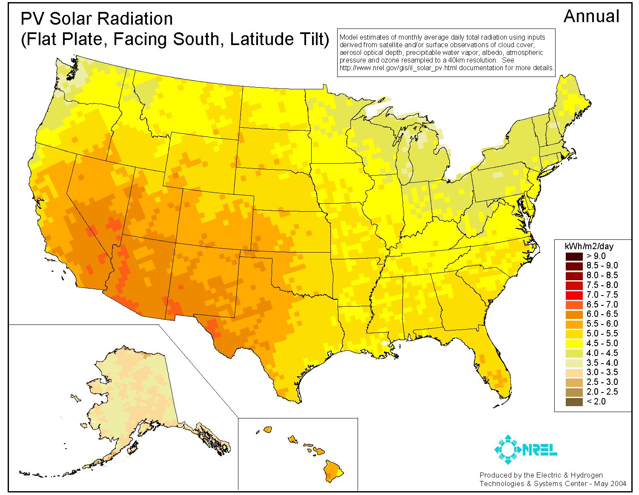
US Solar Potential
12
Source: U.S. Department of Energy (2008) http://apps1.eere.energy.gov/states/alternatives/csp.cfm

Slide 13
Availability of Power
Sunlight is not constant
  Must have supplemental system for evening usage
Capacity Factor: 19% – 21%⁺
Weather conditions impact power
  Less solar radiation in the winter
  Cloudy, overcast days and fog
Potential damage to panels from storms
Dust, pollen, and debris can interfere with panels
  Cleaning may be necessary
⁺Source: La Capra study (2007 data) http://www.energy.sc.gov/publications/Renewables%20Potential%20Final%20Report%20-09-12-2007-B.ppt

Slide 14
Land Usage Considerations
If panels are not placed on existing structures, land use must be considered
Land required is difficult to determine because of variances in solar panel sizes and location
The largest solar facility located in California’s Mojave Desert occupies more than 1,500 acres⁺
⁺Source: NextEra Energy Resources www.nexteraenergyresources.com

Slide 15
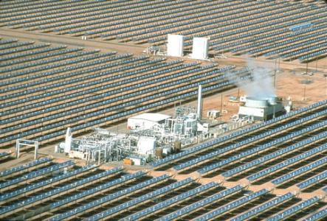
Solar Electric Generating Systems
California’s Mojave Desert
354 MW capacity
Nine solar plants
900,000 mirrors
1,550 acres
Includes natural gas “back-up”
Location receives more than 7 kWh/meter²/day
Solar Electric Generating Systems IV
15
Source: NextEra Energy Resources www.nexteraenergyresources.com

Slide 16
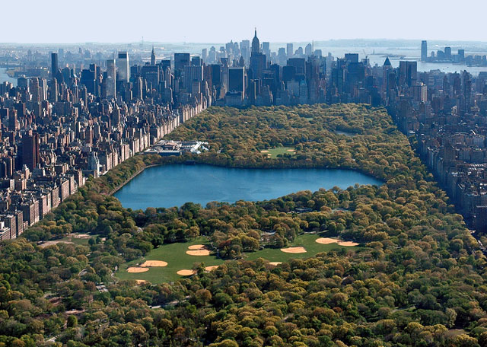
How large is 1,550 acres?
Riverbanks Zoo: 170 acres
University of South Carolina campus: 384 acres
Central Park: 843 acres
Sesqui State Park: 1,440 acres
1,550 acres = 1,174 football fields
Half of Central Park’s 843 acres
16

Slide 17
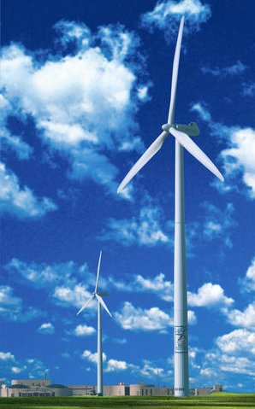
Wind Energy
Converting the Earth’s wind into electricity
17

Slide 18
Advantages of Wind Power⁺
Air emissions are insignificant because no fuels are combusted
  No sulfur dioxide emissions
  No nitrogen oxide emissions
  No carbon dioxide emissions
Wind turbines do not require the use of water to generate electricity
  Not affected by drought or limited water resources
  No concern of environmental impact on rivers and lakes
  Minimal water may be needed to clean blades if there is not sufficient rainfall
⁺ Source: U.S. Environmental Protection Agency (2007) http://www.epa.gov/cleanenergy/energy-and-you/affect/non-hydro.html

Slide 19
Advantages of Wind Power⁺
Supplies are unlimited when the wind blows
No ash or spent fuel created
When turbines are removed from land, there are no solid wastes or fuel residues left behind
⁺ Source: U.S. Environmental Protection Agency (2007) http://www.epa.gov/cleanenergy/energy-and-you/affect/non-hydro.html

Slide 20
Disadvantage of Wind Power: Costs
Average installed costs of onshore wind power: $1,800 to $2,000 per KW ⁺
Average installed costs of offshore wind power: $2,800 to $3,300 per KW ⁺
Costs of producing energy vary based on location
Estimated cost of electricity ranges from 12 to 15.5 cents per kWh⁺
⁺ Source: La Capra study (2007 data) http://www.energy.sc.gov/publications/Renewables%20Potential%20Final%20Report%20-09-12-2007-B.ppt

Slide 21
Geographic Limitations
Grid-connected turbines are typically rated for wind speeds of 14 meters per second (31 mph) ⁺
South Carolina does not have sufficient on-shore wind speeds to support this form of energy
  Mean Annual wind speed:
    70 meters (230 ft): 6.5 – 7.0 m/s (14.5 – 15.7 mph)*
Some offshore wind power might be available
⁺ Source: GE Energy (2005) http://www.gepower.com/prod_serv/products/wind_turbines/en/36mw/36mw_specs.htm
* Source: S.C. Energy Office (2003) http://www.energy.sc.gov/publications/SC_spd70m_8April2005.pdf

Slide 22
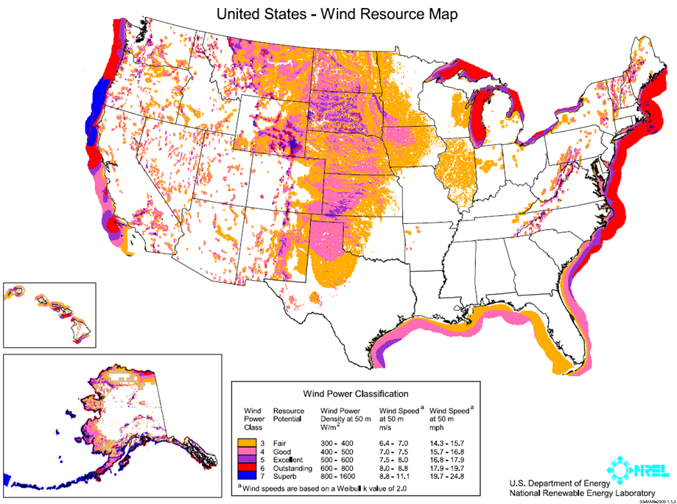
22
22
* Source: U.S. Department of Energy (2009) http://www.windpoweringamerica.gov/wind_maps.asp

Slide 23
Offshore Limitations⁺
Underwater transmission lines are very costly so project within 10 miles of the shore would be ideal
The northern part of SC has some potential for offshore projects
Offshore permitting is more complicated in federal waters (>3 miles offshore)
Potential damage from hurricanes
  GE Wind: Turbines can sustain up to 130 mph winds (Category 3 hurricane)
  S.C., N.C., and Georgia experienced 21 Category 3 hurricanes or greater since 1851.
⁺ Source: La Capra study (2007 data) http://www.energy.sc.gov/publications/Renewables%20Potential%20Final%20Report%20-09-12-2007-B.ppt

Slide 24
Availability Limitations
Wind is intermittent meaning it does not constantly blow
Must have backup for non-windy times
Capacity Factor: 25% – 35%⁺
Wind is not dispatchable, meaning it can not be turned on or off based on demand
⁺ Source: La Capra study (2007 data) http://www.energy.sc.gov/publications/Renewables%20Potential%20Final%20Report%20-09-12-2007-B.ppt

Slide 25
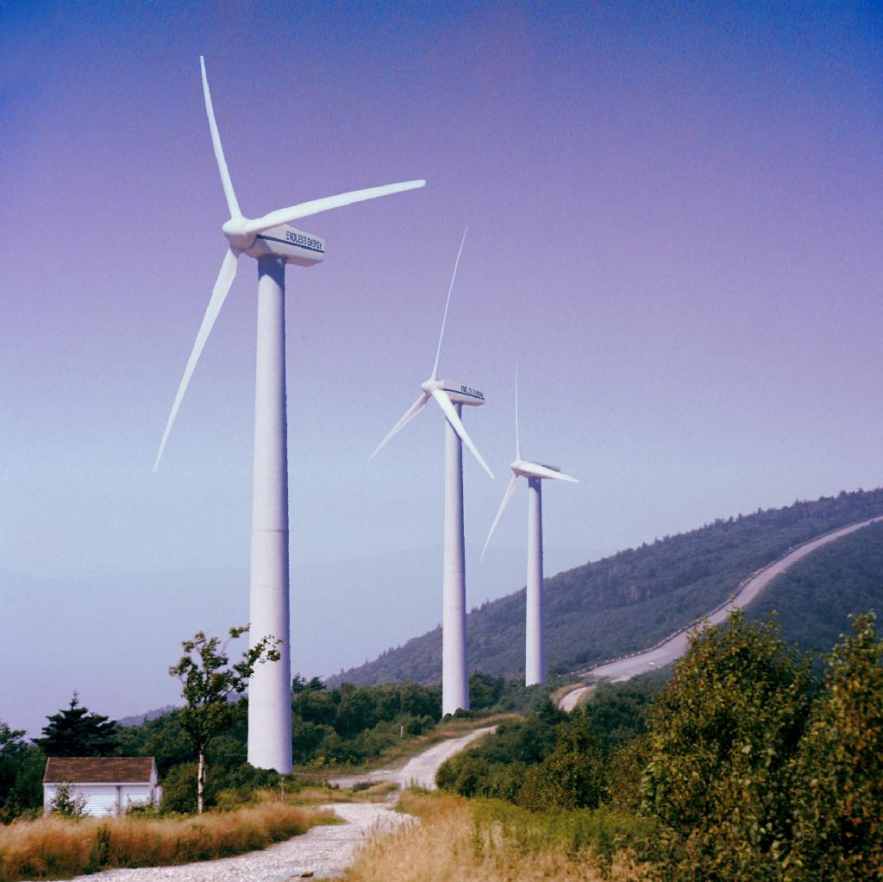
Wind Turbine Sizes
GE 3.6 MW Model ⁺
Blades: approx 160 ft each (half of a
football field)
Tower: 295 ft
Total Height: 455 ft (38 stories –
Columbia’s Capital Center: 25 stories)
Vertical Airspace: 364 ft
Weight: 164 Tons (69 Ford F-150 trucks or 112 Toyota Prius cars)
Platform:
  1,000 tons cement/steel rebar
  30-50 feet across
  6-30 feet deep
25
⁺ Source: GE Energy (2005) http://www.gepower.com/prod_serv/products/wind_turbines/en/36mw/36mw_specs.htm

Slide 26
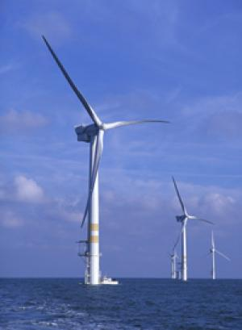
Cape Wind
Nantucket Sound, MA
Proposed Project:
Capacity: 420 MW
Acres: 16,000 (Larger
than Myrtle Beach, SC)
Wind Turbines: 130
Cost: Undisclosed
34 acres per MW
26
⁺ Source: Cape Wind (2009) www.capewind.org

Slide 27
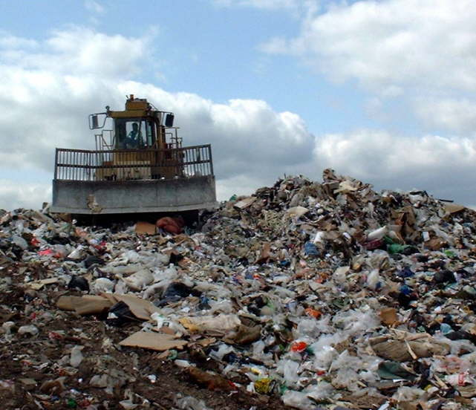
Biomass: Landfill Gas
Landfills contain methane which can be
captured and combusted for energy
27

Slide 28
Landfill Gas (LFG)
Advantages:
Methane is captured to produce electricity
Prevents the emission of methane, a greenhouse gas which is a harmful GHG that is prevalent in landfills
Capacity factor is 80 – 85% which is higher than other renewable resources⁺
⁺ Source: La Capra study (2007 data) http://www.energy.sc.gov/publications/Renewables%20Potential%20Final%20Report%20-09-12-2007-B.ppt

Slide 29
Landfill Gas (LFG)
Resources are limited – there are only so many landfills able to provide this power
Btu Content: 9,500
Costs: 5.9 - 9 cents per kWh⁺
Current Projects:
Ten LFG projects are online in SC – more planned*
Almost 70% of BMW’s paint shop energy consumption is generated from LFG*
* Source: U.S. Environmental Protection Agency (2009) http://www.epa.gov/landfill/proj/prof/profile/bmwmanufacturinglandfillg.htm
⁺ Source: La Capra study (2007 data) http://www.energy.sc.gov/publications/Renewables%20Potential%20Final%20Report%20-09-12-2007-B.ppt

Slide 30
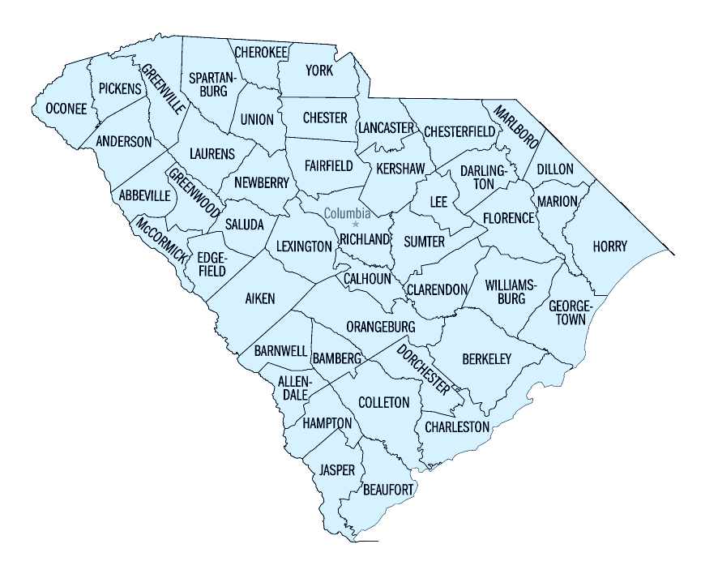
Existing and Potential Landfill Gas to Energy Sites
1
Existing LGTE Projects
Palmetto (BMW)
Enoree
2
Anderson
Wellford
Union County Regional
Northeast Landfill
Georgetown County
Oakridge*
Berkeley County*
Bees Ferry Road
Hickory Hill*
Greenwood
^{(4/1/09)}
Lee
Richland
3
Horry
Langley
4
Three Rivers
5
6
7
8
* Under development or proposed for development
30
Source: U.S. Environmental Protection Agency (2009 data) http://www.epa.gov/lmop/proj/index.htm
Source: La Capra study (2007 data) http://www.energy.sc.gov/publications/Renewables%20Potential%20Final%20Report%20-09-12-2007-B.ppt
Notes:
30

Slide 31
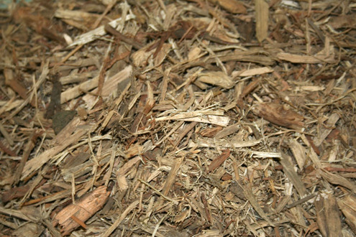
Biomass: Wood and Wood Waste
Burning wood and wood waste to create power
31

Slide 32
Wood and Wood Waste⁺
Wood waste, logging residue and commercial thinning can be used in:
  Direct fire generation (Biomass burned to produce steam to drive turbine engine)
  Co-Fired Generation (Biomass mixed with fossil fuels, such as coal, to generate power)
Emissions (CO₂) exist but carbon footprint is reduced
Reliability is greater than solar or wind
  Capacity Factor: 70% – 75%
⁺ Source: La Capra study (2007 data) http://www.energy.sc.gov/publications/Renewables%20Potential%20Final%20Report%20-09-12-2007-B.ppt

Slide 33
Wood and Wood Waste⁺
Considerations:
Limited by the availability of fuel
Long-distance transportation not ideal
Btu content: 12,000
Costs are approximately 9 to 13.5 cents per kWh
⁺ Source: La Capra study (2007 data) http://www.energy.sc.gov/publications/Renewables%20Potential%20Final%20Report%20-09-12-2007-B.ppt

Slide 34
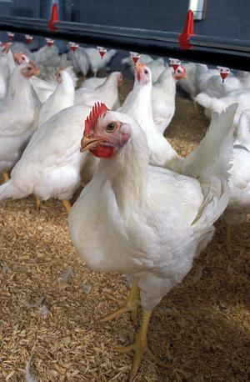
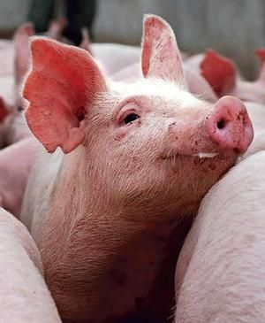
Biomass: Poultry Litter & Swine Waste
34

Slide 35
Poultry Litter & Swine Waste⁺
Historically used as fertilizer but there are concerns about groundwater contamination
Advantages:
Waste is combusted with no new carbon emissions
Reliability is much greater than solar or wind
  Capacity Factor: 70% – 85%
Assists farmers in eliminating waste
Ash can be used as fertilizer
Btu content: 12,000 – 14,000
⁺ Source: La Capra study (2007 data) http://www.energy.sc.gov/publications/Renewables%20Potential%20Final%20Report%20-09-12-2007-B.ppt

Slide 36
Poultry Litter & Swine Waste⁺
Considerations:
Limited by the availability of fuel and cost
  Poultry Litter is more prevalent in South Carolina
  Swine Waste is limited and requires greater transportation
Most likely use is co-firing due to limited resources
Costs are approximately 9 to 13.5 cents per kWh
⁺ Source: La Capra study (2007 data) http://www.energy.sc.gov/publications/Renewables%20Potential%20Final%20Report%20-09-12-2007-B.ppt

Slide 37
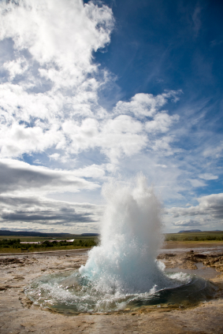
Geothermal Energy
Converting the Earth’s heat into energy

Slide 38
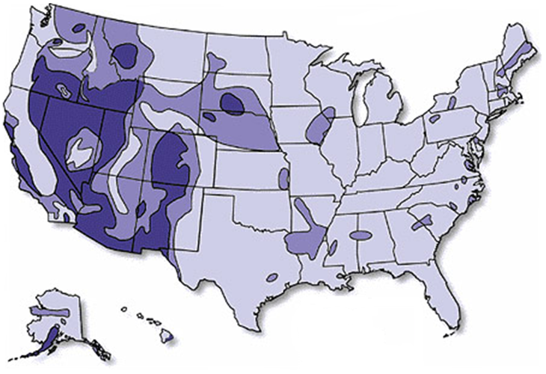
Geothermal Potential
Electric
Direct Heat
Geo. Heat Pumps
Source: U.S. Department of Energy (2008) http://www1.eere.energy.gov/tribalenergy/guide/geothermal_resources.html

Slide 39
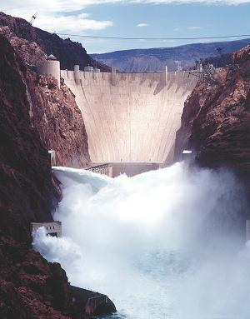
Hydroelectric Energy
Converting the movement of the Earth’s water into energy

Slide 40
What is Clean Energy
Electricity that when generated, does not produce pollution⁺
This includes:
Renewables
Nuclear
⁺Source: Stirling Energy http://www.stirlingenergy.com/news-media/glossary.asp

Slide 41
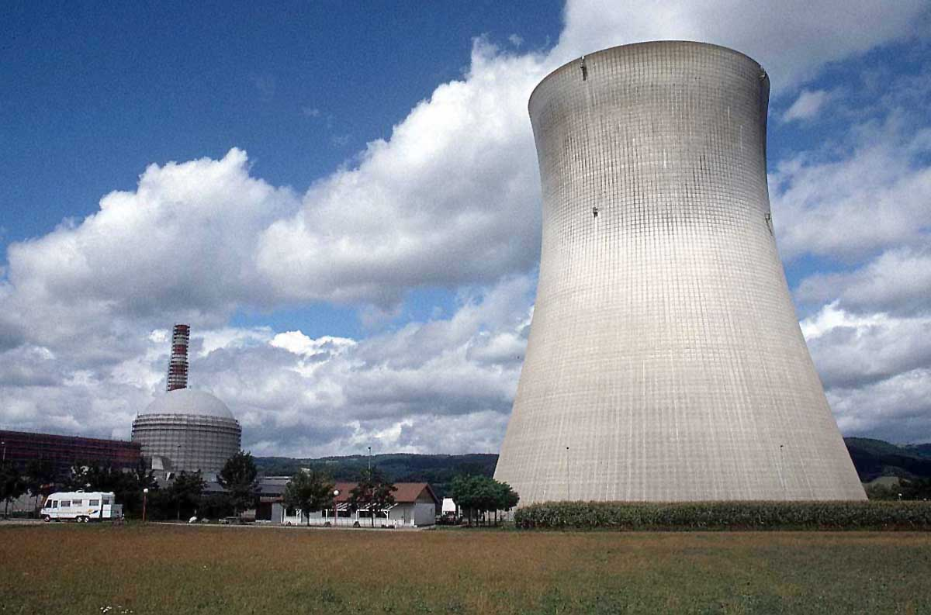
Nuclear Energy

Slide 42
Nuclear Energy
Advantages:
  Does not produce air pollution
  Low fuel and operating costs
  High capacity factor – 92%
Disadvantages
  Water is required for electricity production
  Spent Fuel
    On-site Storage
    Off-site Storage
  High capital costs
+Source: Energy Information Administration (2007 data) http://www.eia.doe.gov/cneaf/electricity/epa/epata6.html

Slide 43
Nuclear Energy⁺
104 reactors in the US
South Carolina: 3rd in US for nuclear energy
7 Reactors in SC
  Catawba 1 & 2 – 6 miles from Rock Hill, SC
  Oconee 1, 2 & 3 – 30 miles west of Greenville
  Robinson 2 – 26 miles from Florence
  V.C. Summer – Jenkinsville – 26 miles from Columbia
+Source: Nuclear Regulatory Commission (2008) http://www.nrc.gov/reactors/operating/map-power-reactors.html

Slide 44
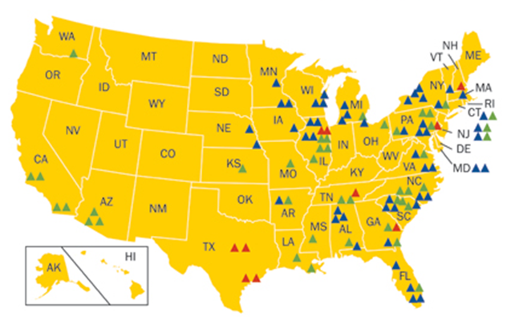
U.S. Commercial Nuclear Power Reactors
Years in Commercial Operation
0-9
10-19
20-29
30-39
+Source: Nuclear Regulatory Commission (2008) http://www.nrc.gov/reactors/operating/map-power-reactors.html

Slide 45
Conclusions
While renewable resources are a part of the solution, they are not the solution
Solar and wind are not economically feasible in South Carolina at this time
Biomass is an option for South Carolina
Geothermal and new hydroelectric are not available for utility-scale generation
Nuclear is an appropriate part of the generation mix for a GHG-constrained society

Slide 46
Questions?

